Slide 1

MSDS-6306-Fall-2019 Case Study 01 - Beer Analysis
Sachin Chavan
Jordan Salsman

Slide 2
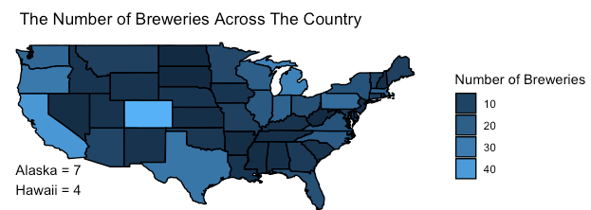
Beer DataSet what is in there?
Breweries Dataset
Item | Count
Breweries | 551
Cities | 384
Beers dataset
Item | Count
Beer names | 2305
Styles | 100

Slide 3
Breweries per state

Slide 4
Missing Data

Slide 5
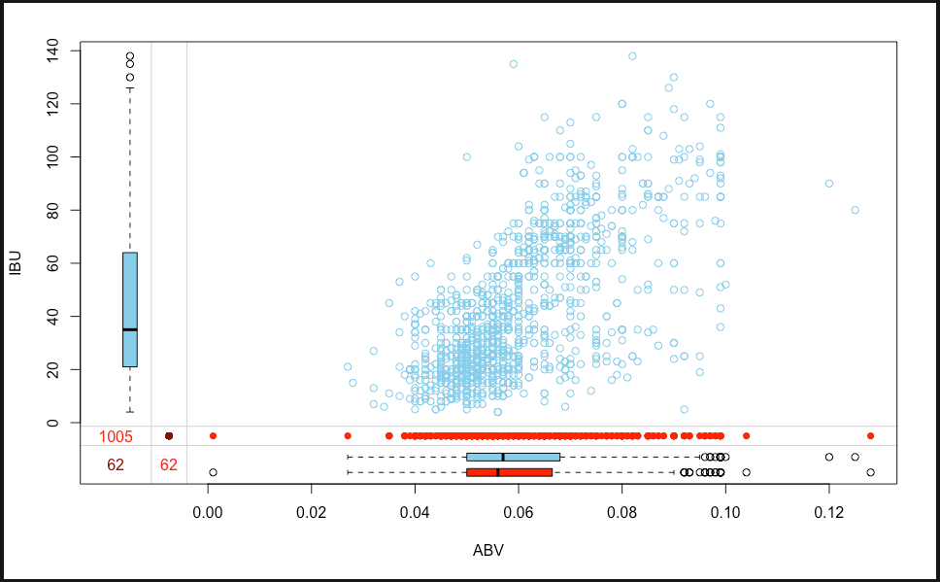
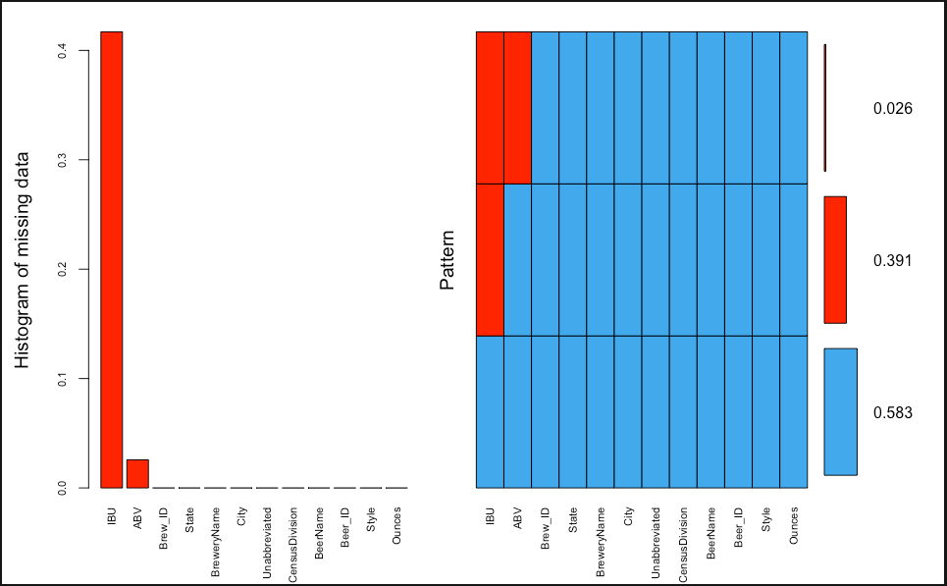
Missing Data Margin plot and aggregation of missing values
Margin plot
Aggregation of missing values

Slide 6
Missing Data Missing completely at random

Slide 7
Imputations
Original Dataset has total 2410
records
Out of 2410, 62 records doesn’t
have both IBU and ABV
These 62 records are deleted
943 records have IBU values
missing
These values are imputed using
simple linear regression model
Log log transformation was
used to build a model
Residual and QQplot on right
side shows model assumptions
on normality and constant
variance are met
Final dataset contains 2348
records
Original Scatterplot
Scatterplot after imputation and transformation
Correlation is .7533
Notes:
bmerged_final_ds <- bmerged_ds %>% filter(!is.na(ABV) | !is.na(IBU))
non_missing_ibu <- bmerged_final_ds %>% filter(!is.na(IBU))
non_missing_ibu$imputed <- "N"
missing_ibu <- bmerged_final_ds %>% filter(is.na(IBU))
missing_ibu$imputed <- "Y"
model_ibu <- non_missing_ibu %>% lm(formula=log(IBU)~log(ABV))
plot(model_ibu)
summary(model_ibu)
missing_ibu$IBU <- round(exp(predict(model_ibu,missing_ibu)),0)
imputed_df <- rbind(non_missing_ibu,missing_ibu)
imputed_df$imputed <- as.factor(imputed_df$imputed)
imputed_df %>% ggplot(aes(x=ABV,y=IBU,color=imputed))+
geom_point()+ggtitle("ABV Vs IBU") +
theme_wsj()+
theme(axis.text.x = element_text(angle=65, vjust=0.3))+
theme(plot.title = element_text(size = rel(0.5)),
plot.subtitle = element_text(size = rel(0.5)),
axis.text.x = element_text(vjust=0.6,size=8),
axis.text.y = element_text(vjust=0.2,size=6),
axis.title = element_text(size = rel(0.5)),
legend.position = "right",
legend.direction ="vertical",
legend.title = element_text(size = rel(0.5)))

Slide 8
Median ABV Vs State
DC and Kentucky has highest median ABV
Notes:
abv_by_states <- imputed_df %>% select(State,ABV) %>% group_by(State) %>% summarise(Median=as.numeric(median(ABV))) %>% arrange(desc(Median))
abv_by_states$State <- factor(abv_by_states$State, levels = abv_by_states$State)
ggplot(abv_by_states, aes(x=State, y=Median)) +
geom_bar(stat="identity", width=.8, fill="tomato3") +
labs(title="Ordered Bar Chart",
subtitle="Median ABV Vs State",
caption="Beer Analysis") +
xlab("State")+
ylab("Alcohol content")+
theme_wsj()+
theme(axis.text.x = element_text(angle=65, vjust=0.6))+
theme(plot.title = element_text(size = rel(0.5)),
plot.subtitle = element_text(size = rel(0.5)),
axis.text.x = element_text(vjust=0.6,size=7),
axis.title = element_text(size = rel(0.5)),
legend.position = "right",
legend.direction ="vertical",
legend.title = element_text(size = rel(0.2)))
ibu_by_states <- imputed_df %>% select(State,IBU) %>% group_by(State) %>% summarise(Median=as.numeric(median(IBU))) %>% arrange(desc(Median))
ibu_by_states$State <- factor(ibu_by_states$State, levels = ibu_by_states$State)
ggplot(ibu_by_states, aes(x=State, y=Median)) +
geom_bar(stat="identity", width=.8, fill="tomato3") +
labs(title="Ordered Bar Chart",
subtitle="Median IBU Vs State",
caption="Beer Analysis") +
xlab("State")+
ylab("Alcohol content")+
theme_wsj()+
theme(axis.text.x = element_text(angle=65, vjust=0.6))+
theme(plot.title = element_text(size = rel(0.5)),
plot.subtitle = element_text(size = rel(0.5)),
axis.text.x = element_text(vjust=0.6,size=7),
axis.title = element_text(size = rel(0.5)),
legend.position = "right",
legend.direction ="vertical",
legend.title = element_text(size = rel(0.2)))

Slide 9
Median IBU Vs State

Slide 10
States by Alcohol content
State of Colorado has maximum alcoholic content with ABV=0.128.

Slide 11
States by bitterness
State of Colorado consumes most bitter beer with IBU=157

Slide 12
Distribution of the ABV
As per box plot Alcohol content varies by state,
Colorado is the state with highest alcohol content
And Delaware is the lowest alcohol content.
Overall Distribution of ABV is slightly right skewed as per histogram above
Notes:
imputed_df %>% ggplot(aes(y=ABV,x=State)) +
geom_boxplot(aes(fill=State), alpha=0.8,show.legend = FALSE) +
labs(title="Alcohol Content",
caption="Beer Analysis") +
xlab("State")+
ylab("Alcohol content")+
theme_wsj()+
theme(axis.text.x = element_text(angle=65, vjust=0.6))+
theme(plot.title = element_text(size = rel(0.5)),
plot.subtitle = element_text(size = rel(0.5)),
axis.text.x = element_text(vjust=0.6,size=7),
axis.title = element_text(size = rel(0.5)),
legend.position = "right",
legend.direction ="vertical",
legend.title = element_text(size = rel(0.2)))
imputed_df %>% ggplot(aes(x=ABV)) +
geom_density(aes(fill=State), alpha=0.8) +
labs(title="Density Plot",
caption="Beer Analysis") +
xlab("State")+
ylab("Alcohol content")+
theme_wsj()+
theme(axis.text.x = element_text(angle=65, vjust=0.6))+
theme(plot.title = element_text(size = rel(0.5)),
plot.subtitle = element_text(size = rel(0.5)),
axis.text.x = element_text(vjust=0.6,size=7),
axis.title = element_text(size = rel(0.5)),
legend.position = "right",
legend.direction ="vertical",
legend.title = element_text(size = rel(0.2)))

Slide 13
IPAs Vs Other Ale

Slide 14
kNN Modeling
Predict IPA or Ale using ABV and IBU
K=5 is the max number of neighbors
The accuracy is 82.55%
Sensitivity is 85.96% (Ale)
Specificity is 77.18% (IPA)

Slide 15
Naive Bayes classifier
Data set is relabeled into only beer color we can be sure of
Using ABV, IBU, and State to classify whether the beer is dark or light
Great marketing tool!
Predicts at 84.21% accuracy
Sensitivity is 97.30% (Light)
Specificity is 75.86% (Dark)

Slide 16
ROC curve
True Positive – Sensitivity
False Positive – Specificity

Slide 17
Conclusion
Following are insights from analysis
There is evidence that data is missing at random
There appears to be geographic clustering of median ABV and IBU
Most beers have moderate Alcohol content (5 to 6.7%)
There is evidence of linear relationship between IBU and ABV

